Slide 1


Pharos
A lighthouse for drug safety
Sudo Salinger
Member 1: Jainish Shah
Member 2: Bhavya Radiya
Member 3: Jinam Shah

Slide 2
The Crisis
20M+
27K+
$100M
FAERS Reports
Vioxx Heart Attacks
Regulatory Cost
+1M added every year
Before withdrawal in 2004
One missing section can cost this

Slide 3
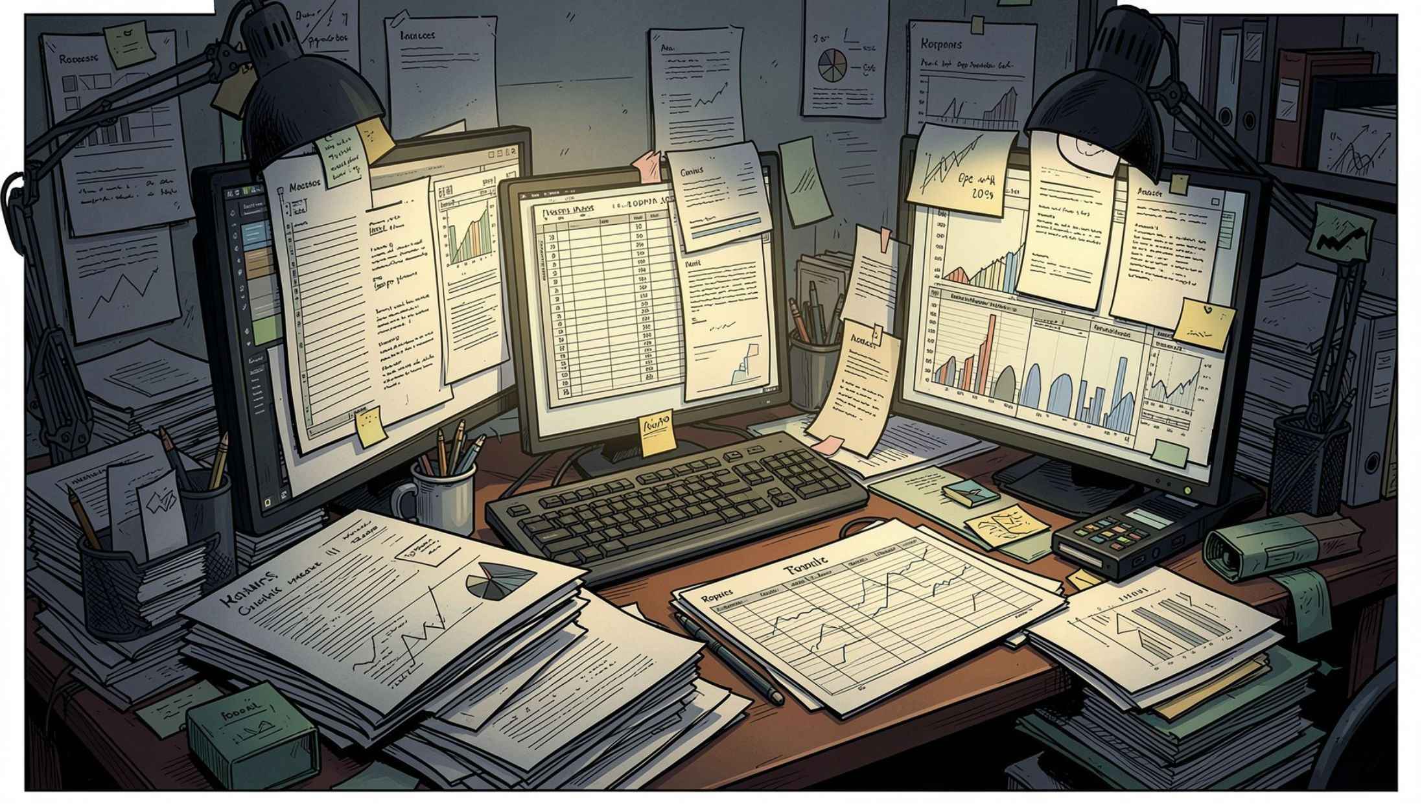
Why Nothing Works Today
Manual Review
Doesn't scale past hundreds of reports
Commercial Platforms
Expensive, closed, and periodic
Notebook Scripts
Untested and irreproducible
Plain LLM Chat
Invents data confidently

Slide 4
The Solution
Two modes. One engine.
Signal Detection
Submission Readiness
Live openFDA → statistical analysis (PRR, ROR, χ², IC) → rank → cluster by organ system
ICH M4 CTD as 69-section checklist → match outline → per-module score → ranked gaps

Slide 5
Bob AI: The Engine Behind Pharos
Pharos is powered by Bob AI, our proprietary intelligence that processes vast amounts of information with precision and accuracy.
Interprets Evidence
Matches Regulations
Accurately reads and interprets complex medical evidence, ensuring data integrity without hallucination.
Connects regulatory requirements with relevant drug safety data, streamlining compliance efforts.
Learns from History
Surfaces Hidden Insights
Continuously learns from historical cases like Vioxx and Avandia to prevent future adverse events.
Identifies critical patterns and insights that human reviewers might otherwise overlook, enhancing safety monitoring.
Bob AI is the deterministic engine that powers both modes of Pharos. It reads evidence, doesn’t invent it, and learns from every case to catch safety signals earlier.

Slide 6

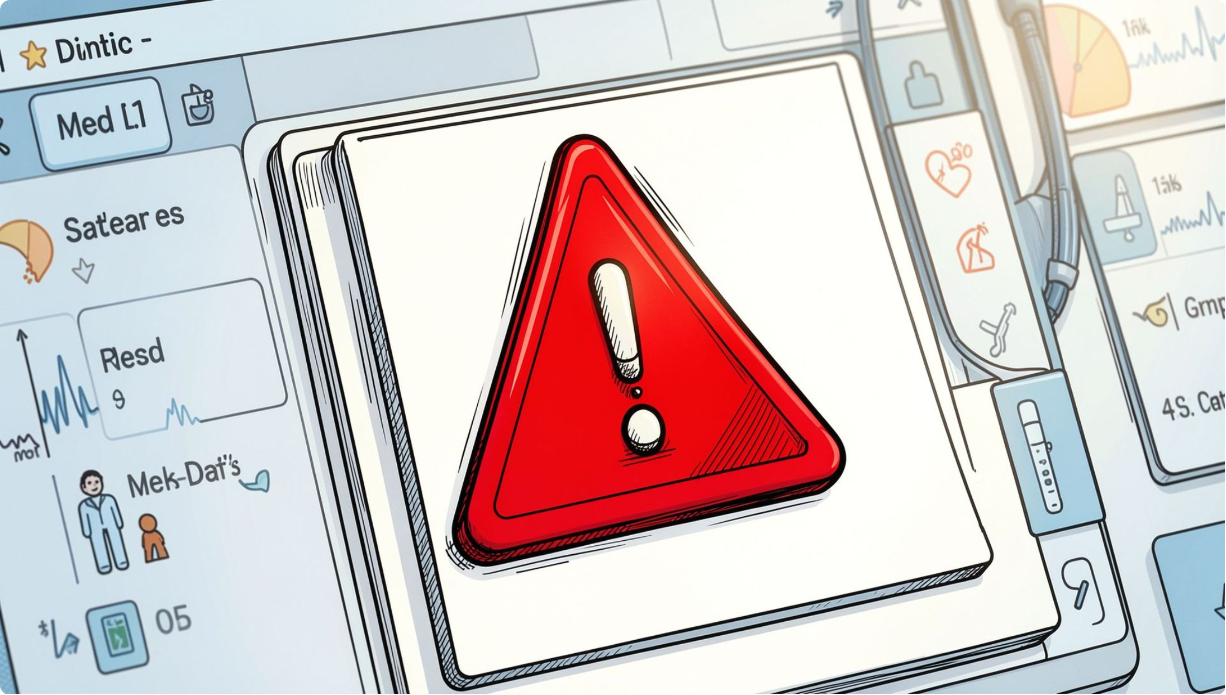
Vioxx: What the Data Reveals
Cardiac SOC cluster: 8 signals across 35,521 cases — all surfaced automatically.
Myocardial Infarction
17,981 cases — PRR 52.2 [51.5–52.8]
Coronary Artery Disease
4,156 cases — PRR 72.2 [70.0–74.5]
Cerebrovascular Accident
13,370 cases — PRR 39.1 [38.5–39.7]

Slide 7
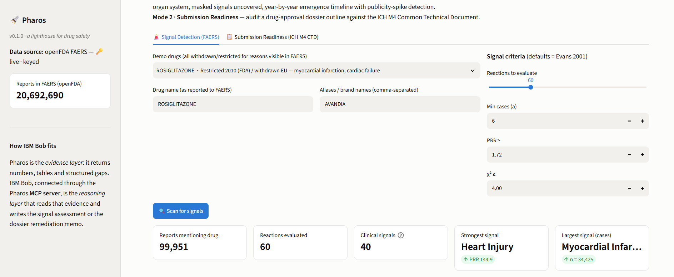
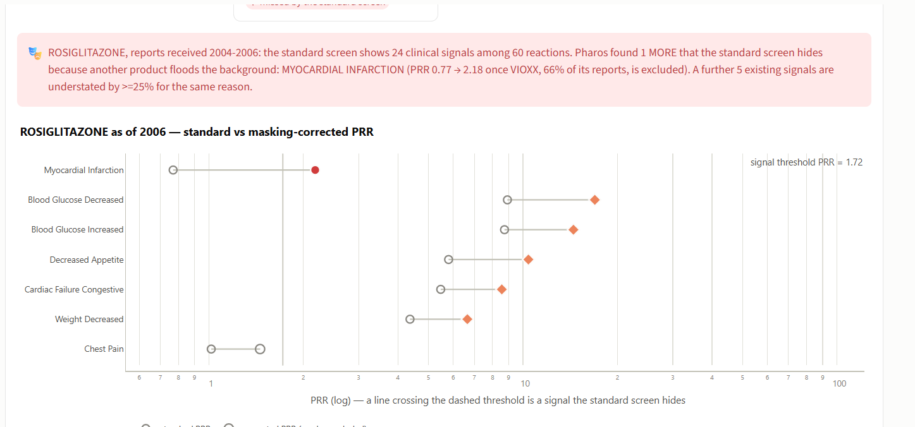
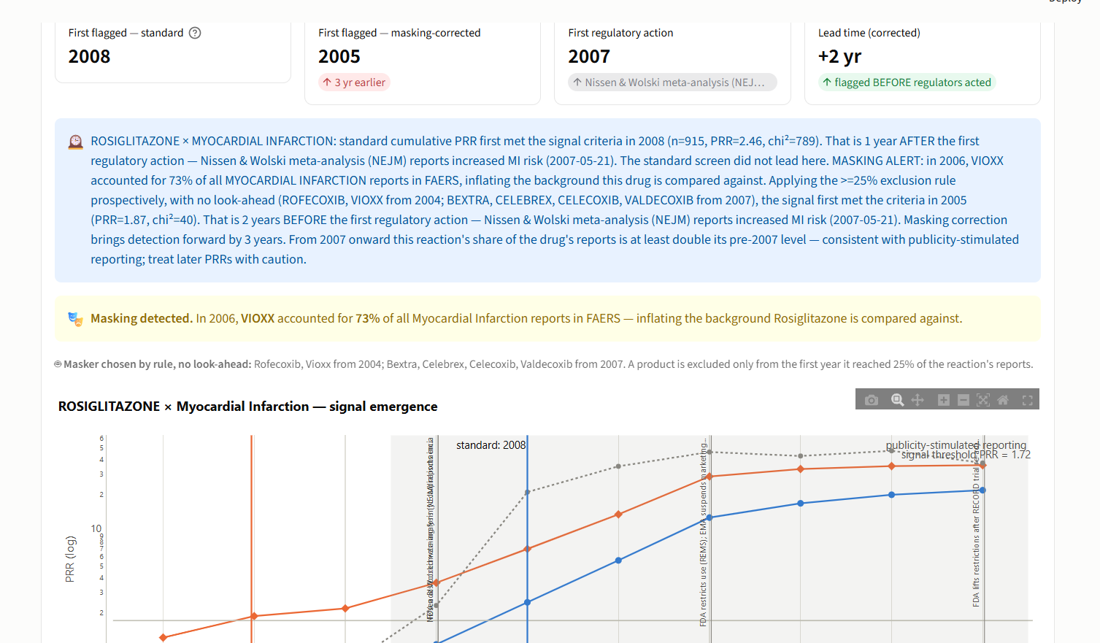
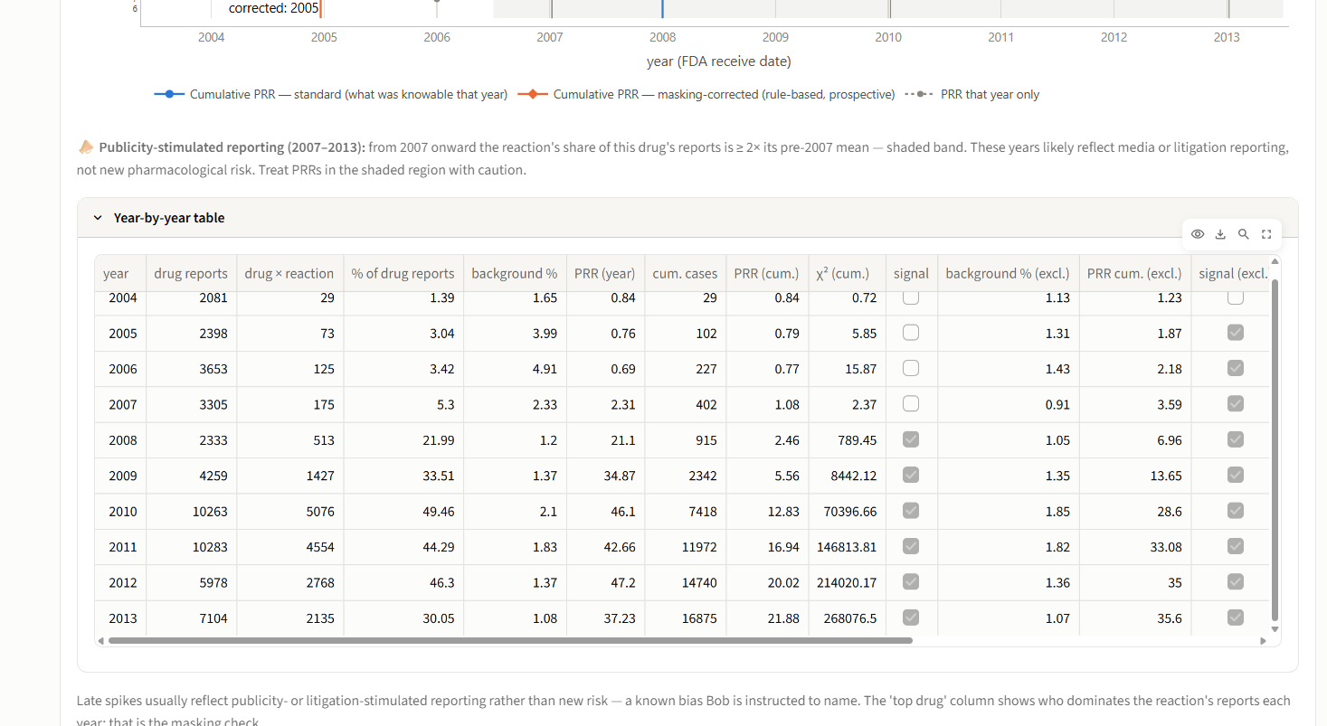
Signal Detection Dashboard
Live ranked signals, organ-system clusters, and statistical confidence — at a glance.

Slide 8
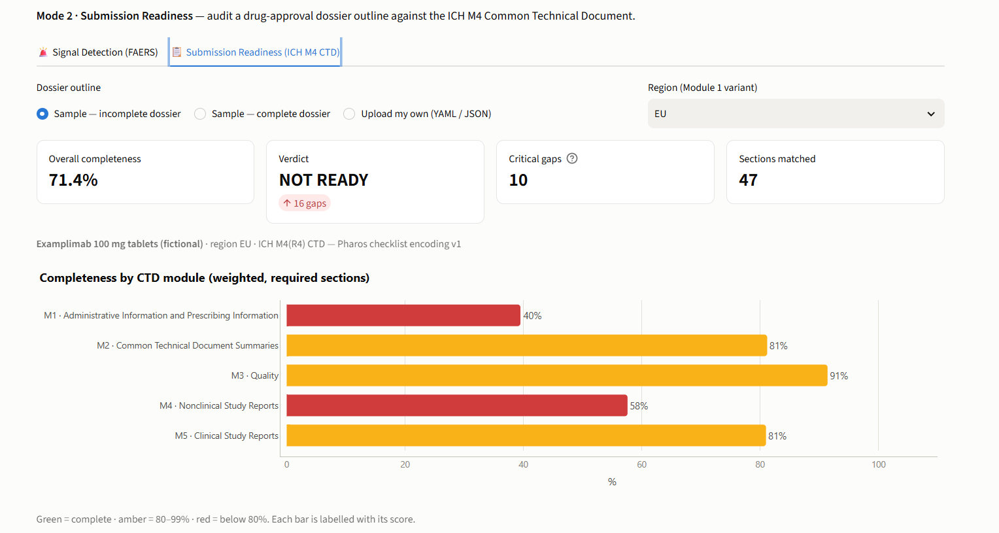
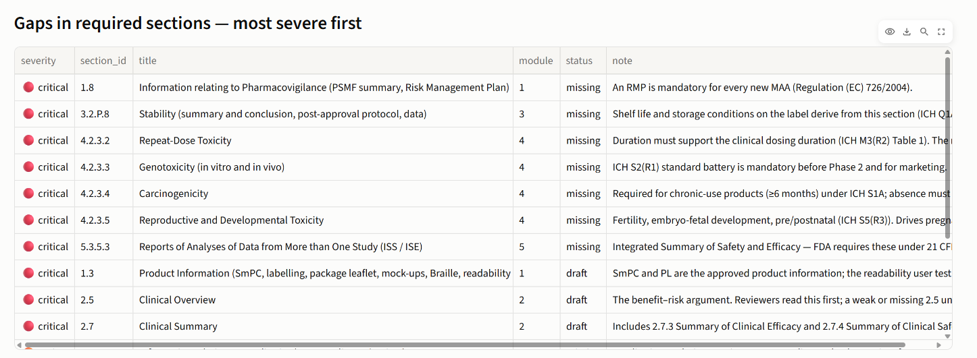
Submission Readiness View
69-section ICH M4 CTD checklist — per-module scores and ranked gaps surfaced instantly.

Slide 9
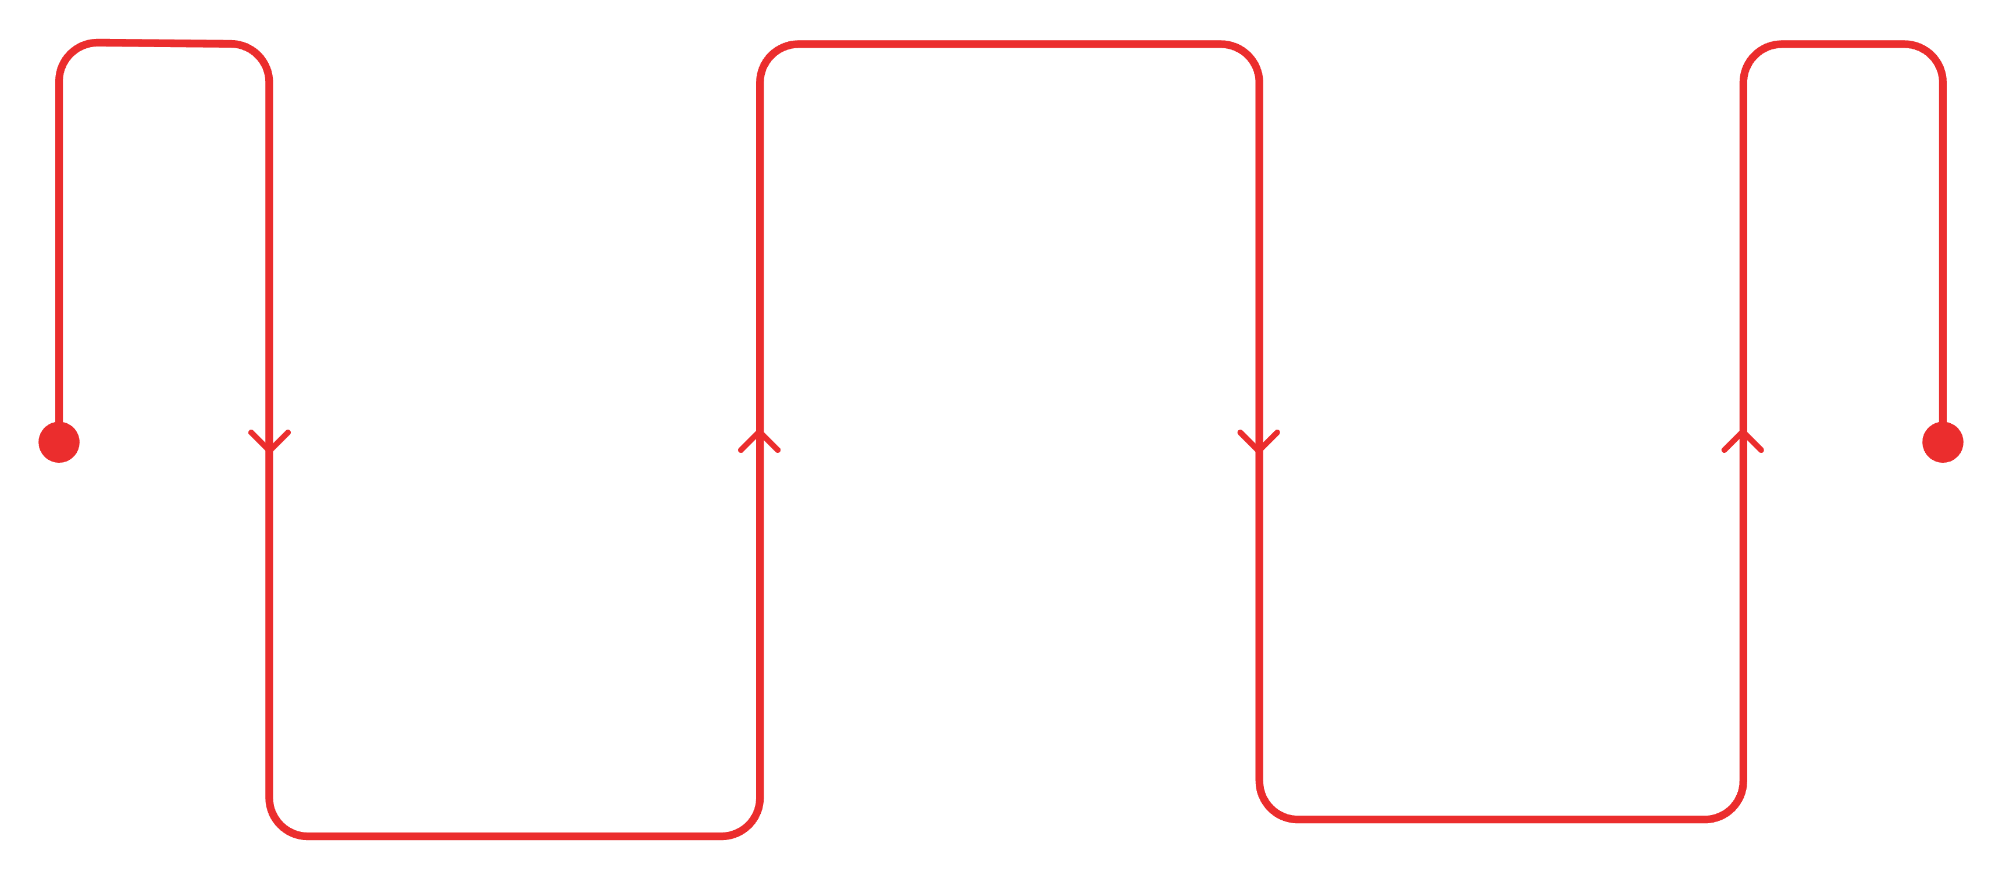

The Avandia Timeline
When could we have known?
Nissen meta-analysis 2007
Raised cardiovascular safety concerns
Vioxx-excluded 2006
Standard 2008 screen
Screen flags Avandia two years earlier
Flags Avandia after 2007 signals
Two years earlier detection — enough time to prevent thousands of adverse events.

Slide 10
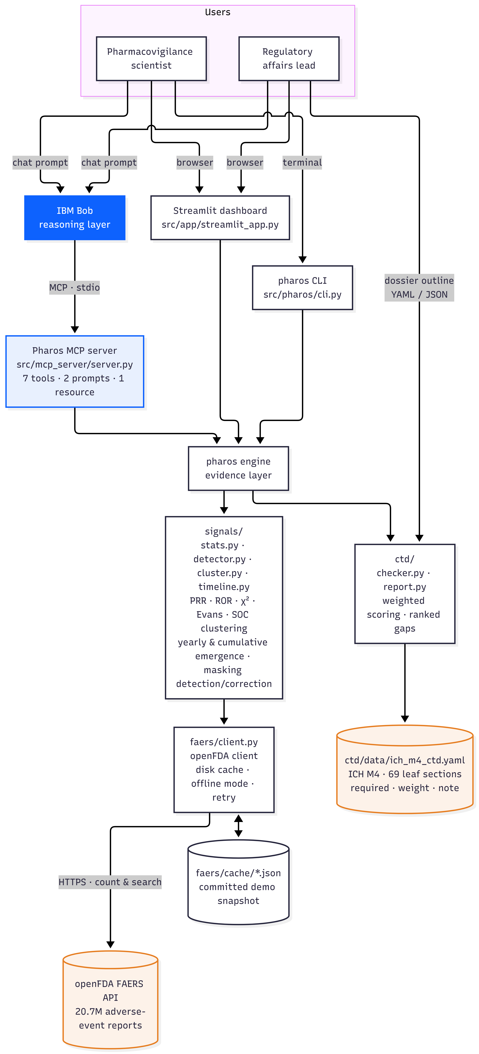
The Architecture

Slide 11
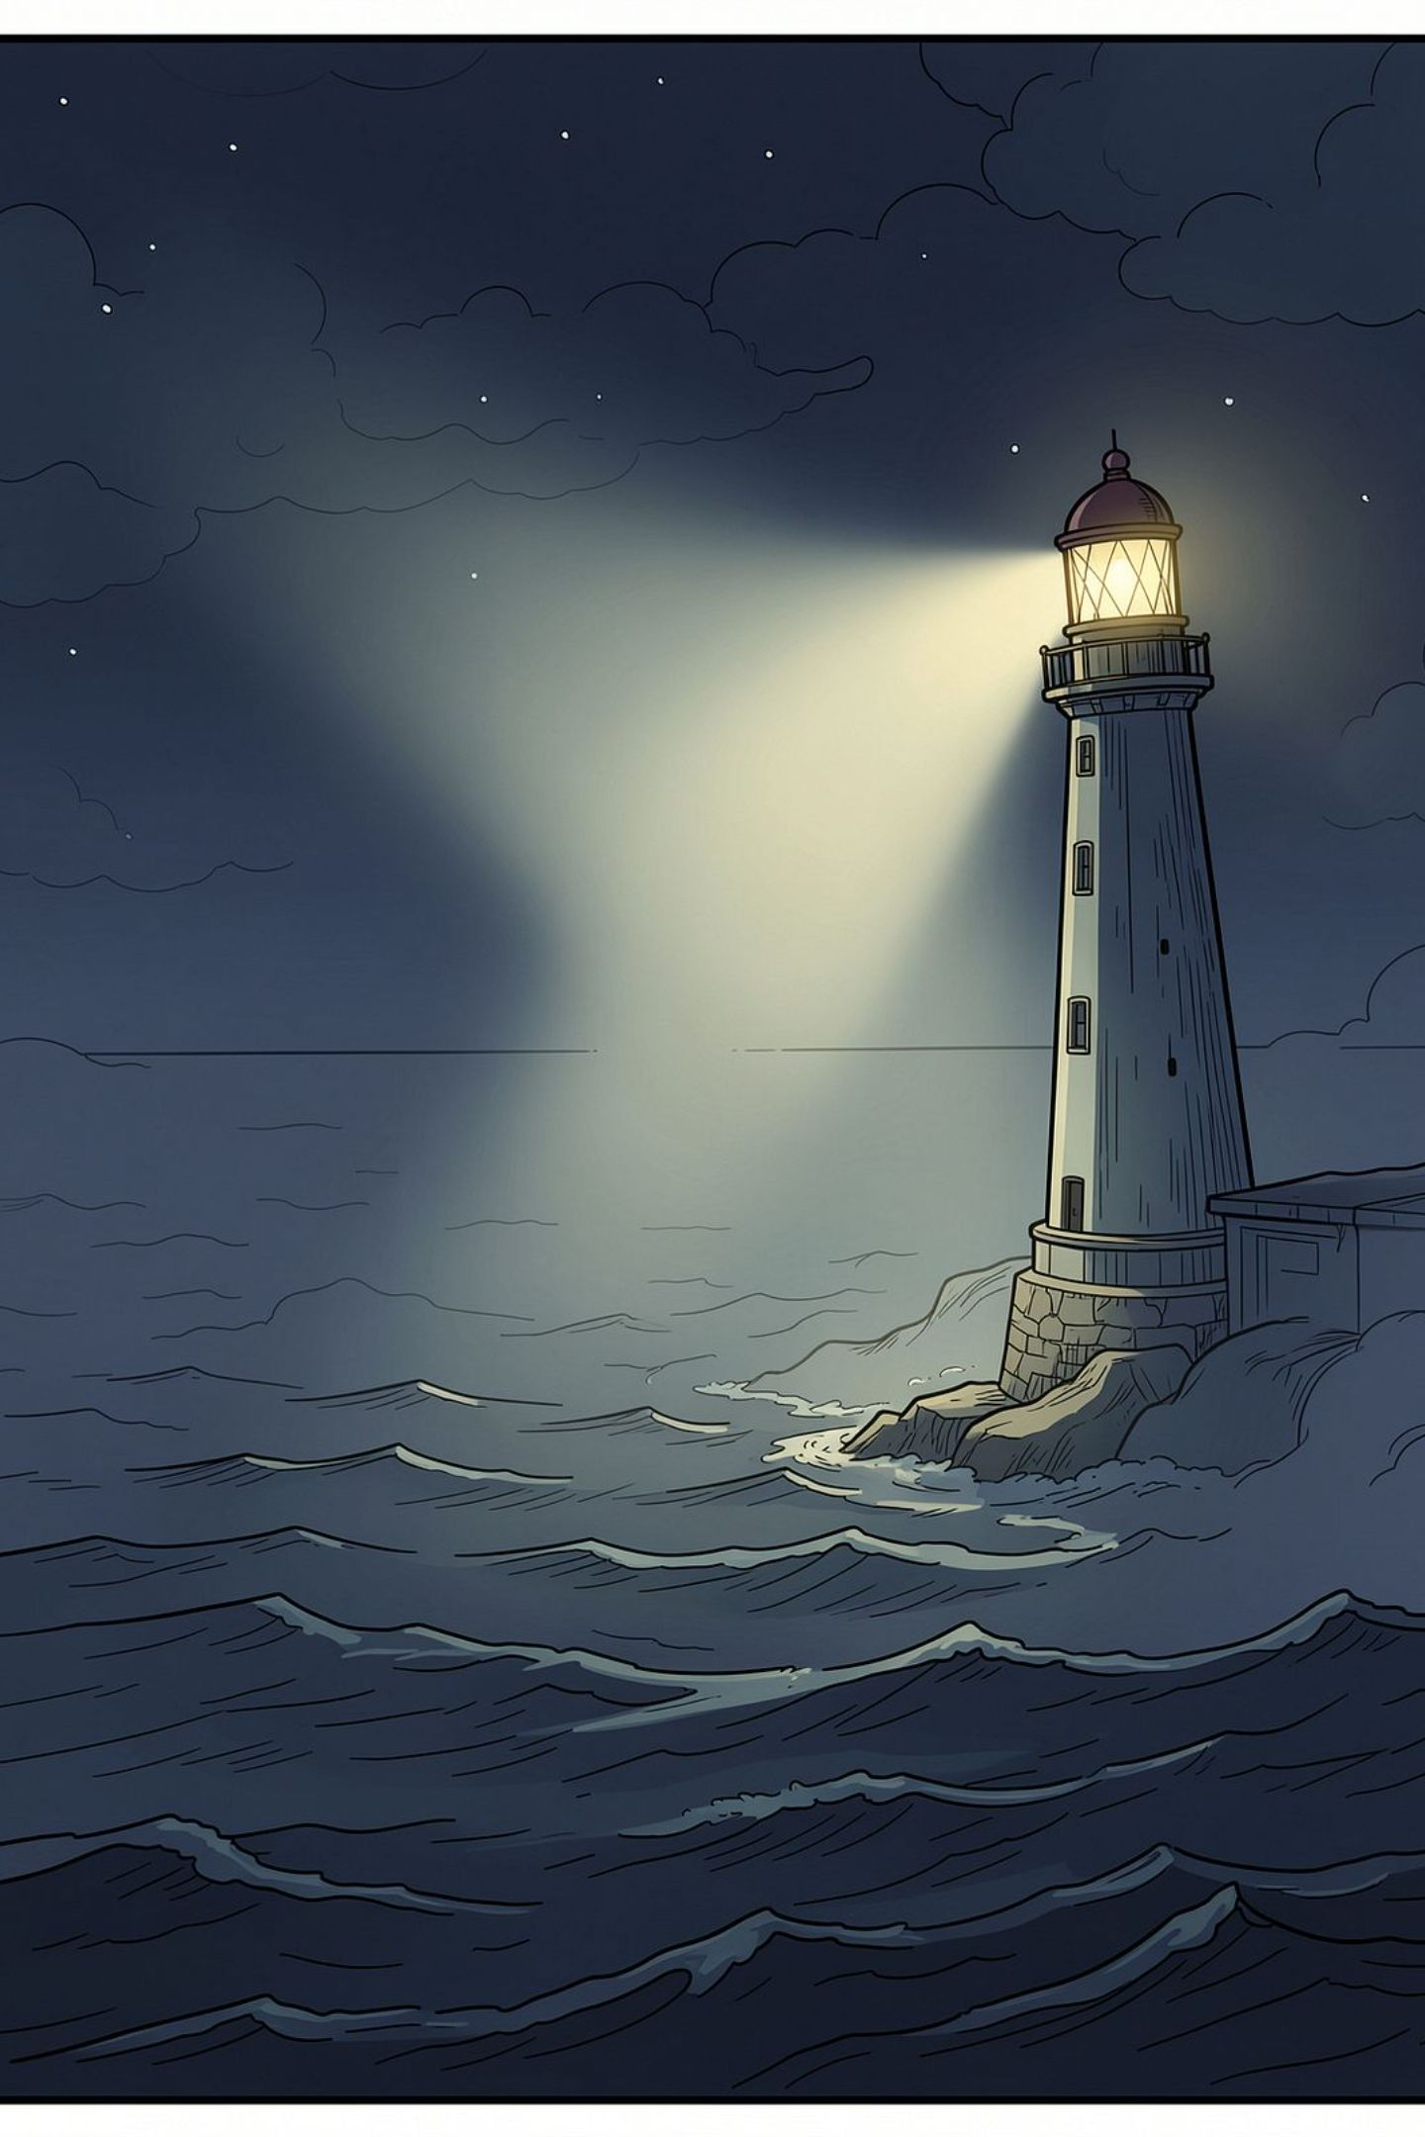
Pharos
Built at IBM hackathon. Designed to be the signal in the noise — before the next Vioxx.
Open
Auditable
Live openFDA. No black box.
Every stat is reproducible.
Earlier
Two years can save lives.

